Slide 1

Creating OneMinneapolis
Our Approach to Community Impact
2018 Competitive Grant Round

Slide 2
Agenda
Introductions and Community Impact Staff
Community Impact Approach
2018 Application Process and Timeline
Three Focus Areas and Key Drivers
2018 Grant Round Eligibility, Criteria and Tips
Frequently Asked Questions

Slide 3
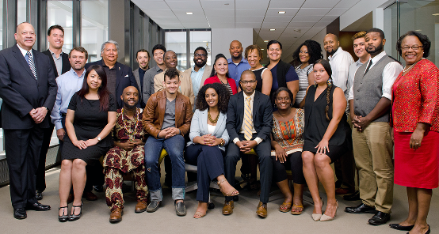


Three Focus Areas:
Civic Engagement, Economic Vitality & Education

Slide 4
Intro & Staff Contacts
Catherine Gray
Director of Impact Strategy,
Civic Engagement
cgray@mplsfoundation.org
(612) 672-3876
Jo-Anne Stately
Director of Impact Strategy,
Economic Vitality
jstately@mplsfoundation.org
(612) 672-3831
Patrice Relerford
Director of Impact Strategy,
Education
prelerford@mplsfoundation.org
(612) 672-3853
Andrea Porter
Grants Administrator
aporter@mplsfoundation.org
(612) 672-8663
Rush Merchant III
Administrative Assistant
rmerchant@mplsfoundation.org
(612) 672-3847
Dea Cortney
Administrative Associate
dcortney@mplsfoundation.org
(612) 672-3875

Slide 5

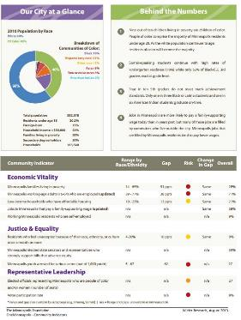

Community Impact Approach
One Minneapolis Report
Strategic Framework & Grant Guidelines
Notes:
Since 2009, the Foundation has focused on community leadership and investments on closing gaps and racial disparities that lock Minneapolis residents out of living wage jobs, make it difficult for people to participate in our democracy and speak up about issue that affect their lives and prevent children from having access to skilled caring adults outside of their family and gaining the skills they need to succeed in the 21st century.
Our competitive grants program strives to be responsive to the needs of the community and increase social, racial, and economic equity with a goal of creating OneMinneapolis. The Foundation supports high-performing nonprofit organizations that primarily serve Minneapolis residents, and we look for innovative projects with systems-changing potential.
We seek to support organizations capable of achieving significant impact in our community, as measured by the OneMinneapolis indicators outlined in the One Minneapolis Report and our Strategic Framework. These two documents are available on our website along with our Grant Guidelines. I will include links to all three documents at the end of this presentation.
Accordingly, we invest the majority of competitive grant resources in proven or promising organizations and initiatives that seek to deepen their impact or bring their work to scale and are significantly aligned with our vision in these three focus areas: Civic Engagement, Economic Vitality and Education.

Slide 6
Community Impact Approach – Continued
Three Focus Areas: Civic Engagement, Economic Vitality and Education
Number of Grants: About 80-90 grants annually
Average grant size: Approximately $50,000 to $60,000
Notes:
Since 2009, the Foundation has focused on community leadership and investments on closing gaps and racial disparities that lock Minneapolis residents out of living wage jobs, make it difficult for people to participate in our democracy and speak up about issue that affect their lives and prevent children from having access to skilled caring adults outside of their family and gaining the skills they need to succeed in the 21st century.
Our competitive grants program strives to be responsive to the needs of the community and increase social, racial, and economic equity with a goal of creating OneMinneapolis. The Foundation supports high-performing nonprofit organizations that primarily serve Minneapolis residents, and we look for innovative projects with systems-changing potential.
We seek to support organizations capable of achieving significant impact in our community, as measured by the OneMinneapolis indicators outlined in the One Minneapolis Report and our Strategic Framework. These two documents are available on our website along with our Grant Guidelines. I will include links to all three documents at the end of this presentation.
Accordingly, we invest the majority of competitive grant resources in proven or promising organizations and initiatives that seek to deepen their impact or bring their work to scale and are significantly aligned with our vision in these three focus areas: Civic Engagement, Economic Vitality and Education.

Slide 7
One
Notes:
Since 2009, the Foundation has focused on community leadership and investments on closing gaps and racial disparities that lock Minneapolis residents out of living wage jobs, make it difficult for people to participate in our democracy and speak up about issue that affect their lives and prevent children from having access to skilled caring adults outside of their family and gaining the skills they need to succeed in the 21st century.
Our competitive grants program strives to be responsive to the needs of the community and increase social, racial, and economic equity with a goal of creating OneMinneapolis. The Foundation supports high-performing nonprofit organizations that primarily serve Minneapolis residents, and we look for innovative projects with systems-changing potential.
We seek to support organizations capable of achieving significant impact in our community, as measured by the OneMinneapolis indicators outlined in the One Minneapolis Report and our Strategic Framework. These two documents are available on our website along with our Grant Guidelines. I will include links to all three documents at the end of this presentation.
Accordingly, we invest the majority of competitive grant resources in proven or promising organizations and initiatives that seek to deepen their impact or bring their work to scale and are significantly aligned with our vision in these three focus areas: Civic Engagement, Economic Vitality and Education.

Slide 8
2018 Community Information Sessions
Wednesday, July 26th 9:00 – 11:00
Tuesday, August 1st 2:00 – 4:00
Cora McCorvey Health & Wellness Center
Great Room
1015 North 4th Avenue
Minneapolis, MN 55405

Slide 9
2018 Application Process and Timeline
Timeline
August 1-25 – Full Proposal Submission
due at 12:00 noon on August 25, late Applications will not be accepted
September-October – Proposal Review and Site Visits with Community Impact Directors
December 22 – Award Notifications

Slide 10
2018 Application Process and Timeline
Two Types of Support
One Application Process, Four Phases
General Operating
Project
Application
Review, Due Diligence and Site Visits
Staff Review and Board Decisions
Annual Review (Grant Report)

Slide 11
Three Focus Areas – Civic Engagement
Our Vision: We live in a robust and truly inclusive democracy.
Success means…
Everyone in our community has influence over the issues that affect their lives.
Diverse leaders, representative of our population, advance equity across sectors.
All communities have the tools, capacity, and relationships to influence public policy.
Participation in our democracy is inclusive.
To succeed, we are investing in work related to these Key Drivers
Increasing the number of people of color who vote.
Strengthening leadership development and organizing capacity in diverse communities.
Advocating for policies that advance equity in civic participation, economic vitality, and education.

Slide 12
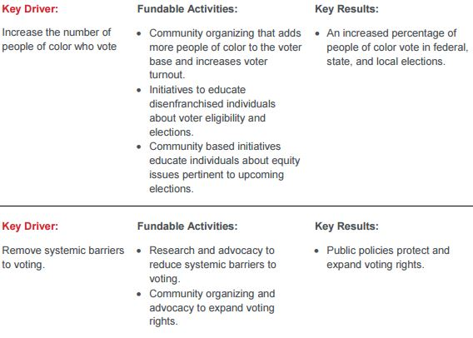
Civic Engagement Key Drivers

Slide 13
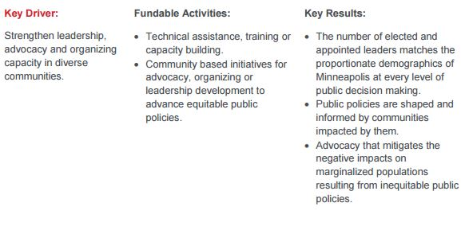
Civic Engagement Key Drivers

Slide 14
Three Focus Areas - Education
Our Vision: All of our children are on track to compete in a global economy, participate in civic life, and pursue their dreams.
Success means…
All students attend high-performing schools.
All students have only excellent teachers.
Parents are full partners in their children’s education.
Students have equal opportunities to explore and develop their interests.
Education leaders innovate in pursuit of academic excellence.
To succeed, we are investing in work related to these Key Drivers
Increasing access to high-quality early childhood education.
Increasing the number of high-performing schools serving low-income students of color.
Strengthening the school talent and leadership pipeline.
Empowering parents, communities, and organizations to advocate for educational equity and excellence.

Slide 15
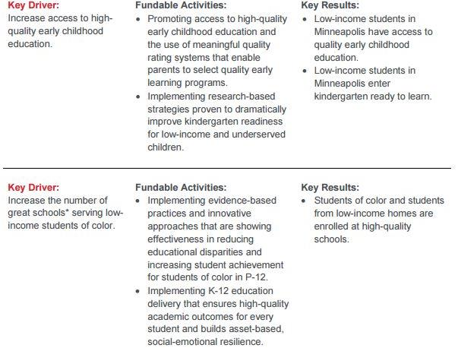
Education Key Drivers

Slide 16
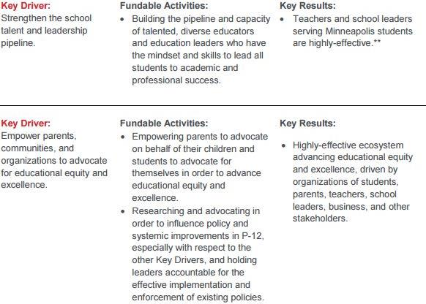
Education Key Drivers - Continued

Slide 17
Three Focus Areas – Economic Vitality
Our Vision: Our workforce reflects our changing demographics, and our business climate fosters innovation, entrepreneurship, and self-sufficiency.
Success means…
Companies can find local workers with the skills they need for today and tomorrow.
All communities are employed at equal and competitive rates.
Small businesses run by people of color grow and flourish.
Residents have tools and opportunities to provide for themselves and their families.
To succeed, we are investing in work related to these Key Drivers
Increasing workforce preparedness.
Building community wealth.
Strengthening the delivery of financial and technical assistance to minority-owned businesses.
Advocating for improved policies and public sector programs that impact workforce development.

Slide 18
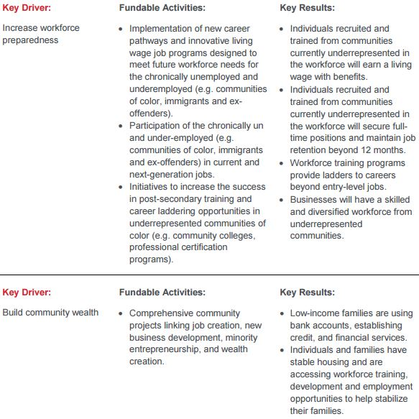
Economic Vitality Key Drivers

Slide 19
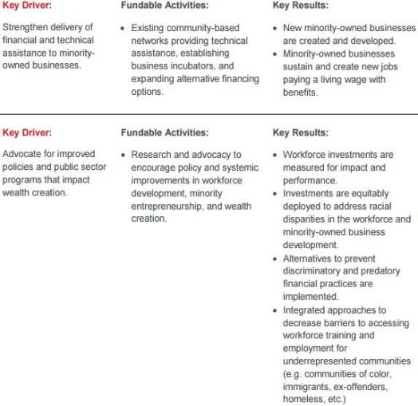
Economic Vitality Key Drivers – Con’t

Slide 20
2018 Grant Round Eligibility, Criteria and Tips
Eligibility
Tax-exempt or under fiscal sponsorship of tax-exempt nonprofit
Primarily serving people of Minneapolis (exception – regional, statewide or national public policy efforts that benefit Minneapolis)
No concurrent grants/one grant at a time
Previously funded organizations must meet all reporting requirements before applying again
If denied funding within past year, contact a Director of Impact Strategy to discuss proposed work and eligibility

Slide 21
2018 Grant Round Eligibility, Criteria and Tips
Key Criteria
Equity Framework
Collaboration
Financial and programmatic capacity
Leadership
Measurable results

Slide 22
2018 Grant Round Eligibility, Criteria and Tips
Tips for Drafting an Application
Provide details (Numbers over Adjectives)
Be concise
Focus on creating a compelling narrative
Demonstrate a connection

Slide 23
2018 Grant Round Eligibility, Criteria and Tips
Exclusions (See Full List on Page 12 of Grant Guidelines)
Individuals
Capital/Construction Costs
Activities outside the state
Direct religious activities
Conferences/Events
Financial deficits
Memberships

Slide 24
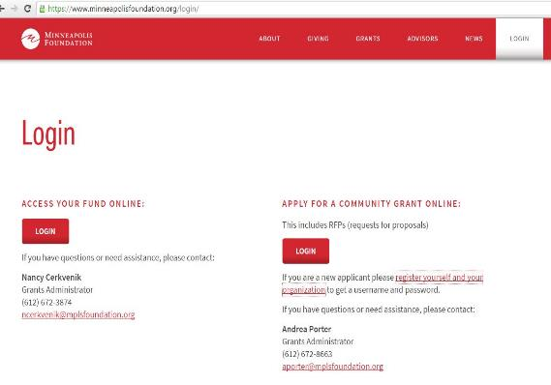
2018 Grant Round Eligibility, Criteria and Tips
Online Application Portal
Please visit minneapolisfoundation.org/login to access the online application portal.
Select the red ‘Login’ button under “Apply for a Community Grant Online.”
New applicants should contact Rush Merchant III at 612-672-3847 to obtain a username and password.

Slide 25
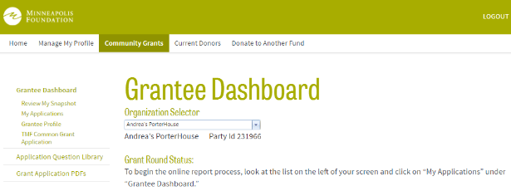
2018 Grant Round Eligibility, Criteria and Tips
Online Application Portal
This page will appear if you’re successfully logged into the online application portal.
Next, select the appropriate Application from the “Grantee Dashboard” menu.
Please don’t wait until the last minute to request a new username or password or register your organization.
The online portal will lock at noon on August 25. No late applications will be accepted.

Slide 26
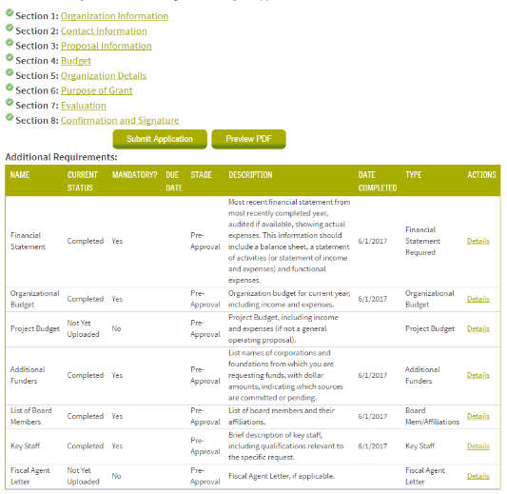
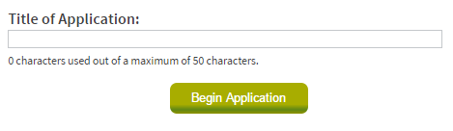
2018 Grant Round - What’s New?
Online Application Portal
My Applications
Title of Application
Workflow and Requirements

Slide 27
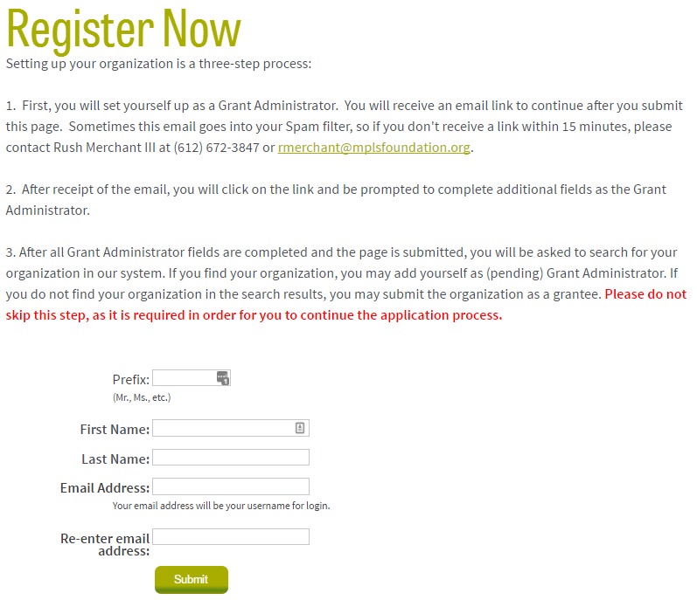
2018 Grant Round Eligibility, Criteria and Tips
Online Application Portal
Questions or trouble logging into the online system?
Please contact Rush Merchant, Administrative Assistant, at
612-672-3847 or rmerchant@mplsfoundation.org

Slide 28
Frequently Asked Questions
How do I know if my organization will be competitive in the application process?
The Minneapolis Foundation’s competitive grant process focuses on nonprofits that share our core values and whose programs are highly aligned with the Key Drivers identified in the each of our three focus areas. While reviewing applications, foundation staff focus upon 1) alignment with the Equity Framework, willingness to collaborate with other organizations, financial stability and programmatic capacity, the strength of the organization’s leadership and the ability to demonstrate a measurable impact.
How soon after I submit my application will my organization receive notification from the Foundation?
Organizations will find out whether or not they will receive funding approximately 16 weeks after the close of the grant application (approximately mid-December).

Slide 29
Does my organization have to submit an LOI or can I just submit the application?
The LOI step has been eliminated from the application process for the 2018 grant round. Only the application is required.
Is there a way for my organization to seek funding from a Donor Advised Fund at The Minneapolis Foundation?
No. The Foundation works directly with individuals and families who have established Donor Advised Funds to help them make charitable gifts to organizations of their choosing. The Foundation does not accept requests for support from these funds.
My organization’s mission and activities align with more than one Focus Area or Key Driver identified by The Minneapolis Foundation. What should I do?
Select the Focus Area and Key Driver that you think most closely aligns with the your organization’s work when completing the application. Our staff is aware that equity issues are complex and many organizations have activities that can be classified under multiple Focus Areas. If our staff feels your work should be under a different Focus Area or Key Driver, we will reassign it and notify you.

Slide 30
Can I submit supplementary materials electronically or through postal mail?
No. The Foundation does not accept supplementary materials. Thoroughly completing every section of the application will give us sufficient information to evaluate your request based on our grantmaking priorities. Foundation staff will contact your organization if we wish to review additional information.
How much time should I set aside to complete the application?
  This will vary for each organization. Our team recommends previewing the Application (word documents are available on our website) several weeks in advance of the August deadline. Next, gather the data and related information you will need and set aside two to four hours to draft and edit your Application in Microsoft Word and submit your work through our online portal.
Can my organization submit an application through email or postal mail?
No. Only applications that are submitted through the foundation’s online system will be accepted. If you are having trouble using the online system, please contact Andrea Porter, Grants Administrator, at 612-672-8663 or aporter@mplsfoundation.org

Slide 31
Are the applications and/or grant rounds for The Minneapolis Foundation and the Robins, Kaplan, Miller & Ciresi (RKMC) Foundation for Children linked? How do I submit an application for a grant from the RKMC Foundation for Children?
No. The Minneapolis Foundation and the RKMC Foundation for Children are separate entities with separate grant rounds and applications. For more information, please visit the RKMC Foundation for Children website for details regarding their process and application.

Slide 32
Useful Links
Grant Guidelines
http://www.minneapolisfoundation.org/wp-content/uploads/2015/05/Grant-Guidelines-2017-Revised_-4-12-17.pdf
Application preview forms
https://www.minneapolisfoundation.org/grants/how-to-apply/
Strategic Framework
https://www.minneapolisfoundation.org/wp-content/uploads/2016/04/Strategic-Framework.pdf
Online Application Portal
https://www.minneapolisfoundation.org/login/

Slide 33
More Questions?
Please review the Grant Guidelines, then contact the appropriate Director of Impact Strategy. Andrea Porter, Grants Administrator, can answer questions related to the online application system. Please call Rush Merchant III for help resetting your password.
Catherine Gray
Director of Impact Strategy, Civic Engagement
cgray@mplsfoundation.org
(612) 672-3876
Jo-Anne Stately
Director of Impact Strategy, Economic Vitality
jstately@mplsfoundation.org
(612) 672-3831
Patrice Relerford
Director of Impact Strategy, Education
prelerford@mplsfoundation.org
(612) 672-3853
Andrea Porter
Grants Administrator
aporter@mplsfoundation.org
(612) 672-8663
Rush Merchant III
Administrative Assistant
rmerchant@mplsfoundation.org
(612) 672-3847
Dea Cortney
Administrative Associate
dcortney@mplsfoundation.org
(612) 672-3875

Slide 34
Thank You!

