Slide 1
OneMPLS Fund April 2019 Request for Proposals

Slide 2
“You can’t understand most of the important things from a distance; You have to get close.”
― Bryan Stevenson, Just Mercy: a story of justice and redemption

Slide 3
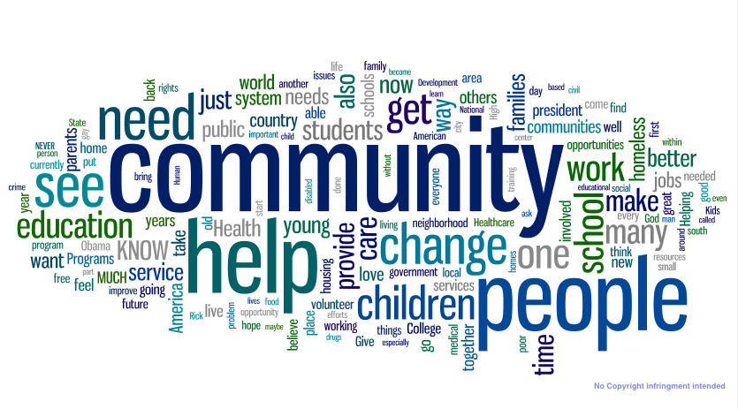
OneMPLS Fund
The OneMPLS Fund was created in 2018 with an initial investment of $1 million from the Minneapolis Foundation to leverage collective resources from the foundation and our donor advisors to leverage advance social, economic and racial equity.
Housing stability will be the focus of the OneMPLS Fund’s first request for proposals (RFP) process in the spring of 2019.
Grants will be awarded through a competitive process directed by Chanda Smith Baker, SVP of Community Impact.

Slide 4
2019 RFP Goal: To support stable housing in order to build stronger families, youth and communities
Why Housing?
The U.S. Department of Housing and Urban Development (HUD) defines housing as affordable when occupants are paying no more than 30 percent of their income on rent. In Minneapolis, rents are increasing at a faster rate than the incomes of low to moderate income households.
Families and individuals with past or current challenges related to mental health, a criminal record or gaps in their work history face even greater challenges in tight housing markets such as Minneapolis.
Source: Star Tribune (August 2018)

Slide 5
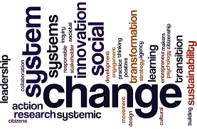
Our Commitment and Focus
The OneMPLS Fund recognizes that community issues are not siloed but often intersect in ways that traditional systems don’t recognize.
Therefore the OneMPLS Fund seeks efforts that identify integrated approaches that bridge issue areas such as mental health and housing, criminal justice and housing, youth and housing and employment and housing.

Slide 6
What We Will Fund
Efforts that strengthen multi-generational approaches to improve family and community stability.
Systems-change efforts that target the policies, practices and approaches that address inequities, thereby removing barriers and/or increasing access to housing opportunity.
Innovative solutions that (a) address a pressing issue, (b) identify an upstream approach, and/or (c) present a catalytic solution that advances equitable outcomes.

Slide 7
Who is Eligible to Apply?
High-performing non-profits and innovative initiatives that advance social, racial and economic equity
Collaborative and/or cross-sector initiatives or tables with a clear action agenda
Those with capacity to measure/evaluate their impact, and a willingness to communicate and disseminate results (sharing of best practices)
Efforts focused in the Twin Cities Metro Area, preferably in the City of Minneapolis

Slide 8
Process
The Minneapolis Foundation will accept online applications for OneMpls Fund through our website during April 2019.
We will fund up to 10 applications. Grants will range from $50,000 to $100,000 for 12 months.
Grants will be announced in July of 2019.
Preference will be given to existing efforts or plans as opposed to endeavors that are in the planning phase.

Slide 9
Next Steps
Please visit http://www.minneapolisfoundation.org/grants/other-funding/ to preview the application for the planning grants.
Submissions are due Thursday, May 23 at 4:30 p.m. via our online system. Late submissions will not be accepted.
Please contact Patrice Relerford at prelerford@mplsfoundation.org with questions about the process or to arrange a call to discuss your ideas.
Please note that we’re not seeking to impose ideas on the community. Instead, we’re seeking your innovative approaches that align with the funding priorities for this opportunity.

Slide 10
Thank you!

